Slide 1
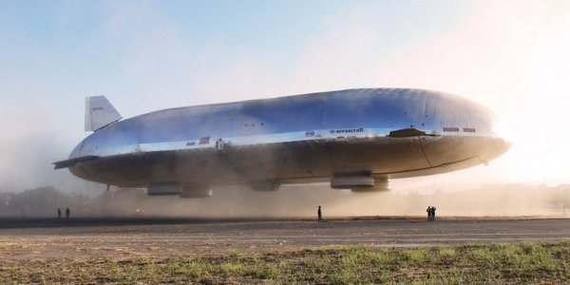
Aeroscraft
By
Paul Floyd
Charles Jennings
Bob Hughes
Alberto Vargas

Slide 2
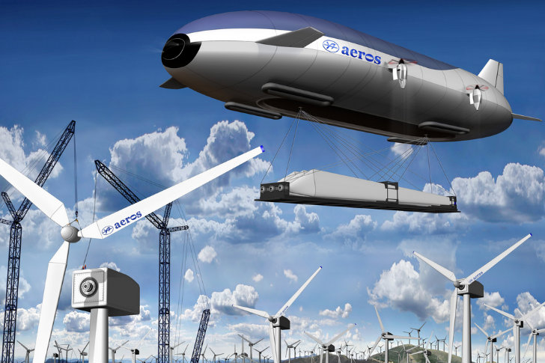
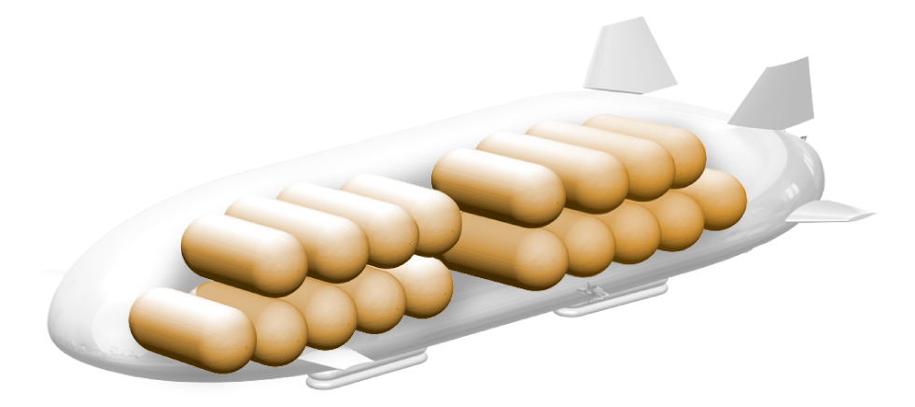
Information
Pros
Based on a 100 year old technology.
Updated with the latest state of the art control systems.
It could be used for passenger carriers, cargo, private air yacht.
Could replace communications satellites.
Could be used as a resupply ship for military, and for civilian use.
Effectively unlimited loiter time.
http://youtu.be/OKMJ3XE-rXA

Slide 3
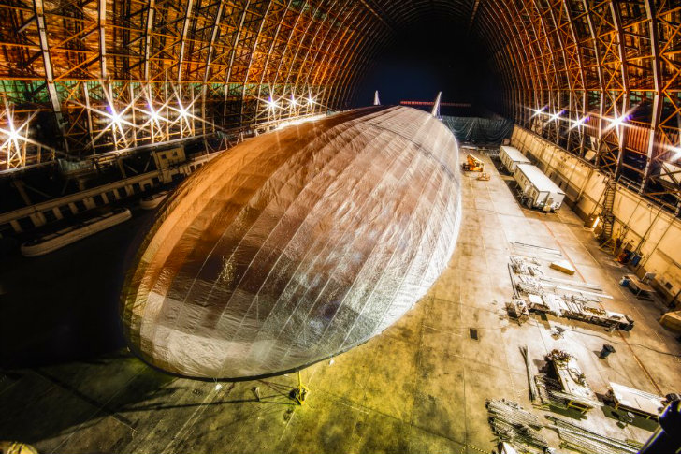
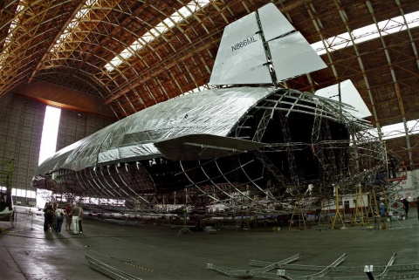
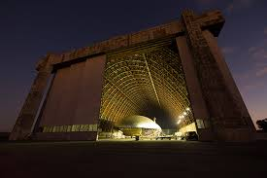
Cons
Very large and hard to store or do maintenance.
Slow.
Not very good to maneuver in bad weather.

Slide 4
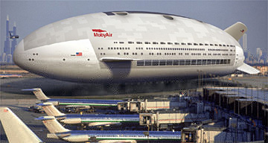
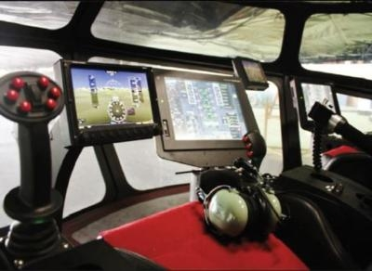
Predictions for the future of this technology
Cheap heavy lift transport.
100% of the globe accessible.
Could replace semi trucks and trains.
Could be used as a RV/ Yacht.

Slide 5
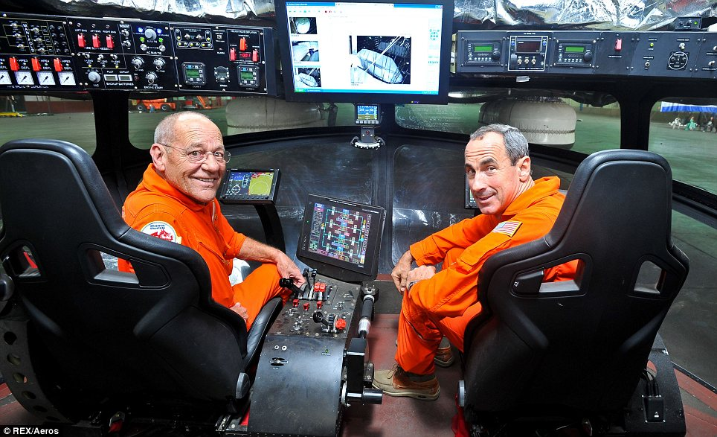
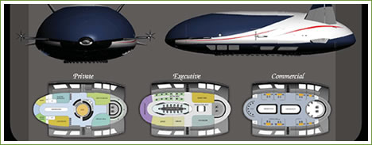
Obstacles of the technology
Set up will be expansive
Would need to build new airports
Large landing pads.
Expensive for initial set up.
Would have to set up a new pilot program to get all the pilots properly trained.

